Slide 1

CERTIFICATE III IN AUTOMOTIVE REPAIR & MAINTENANCE
SUBJECT: Automotive Engineering Workshop
By Ibrahim siraj
Maldives polytechnic

Slide 2
Automotive Engineering Practice
Chapter 1 Applications of Petrol and Diesel Engines
Internal combustion (IC) engines convert chemical energy in fuel into mechanical work.
Two main types:
Petrol (Gasoline) Engines
Diesel Engines
Both are widely used in transportation, power generation, and industrial applications.
By Ibrahim siraj
Maldives polytechnic

Slide 3
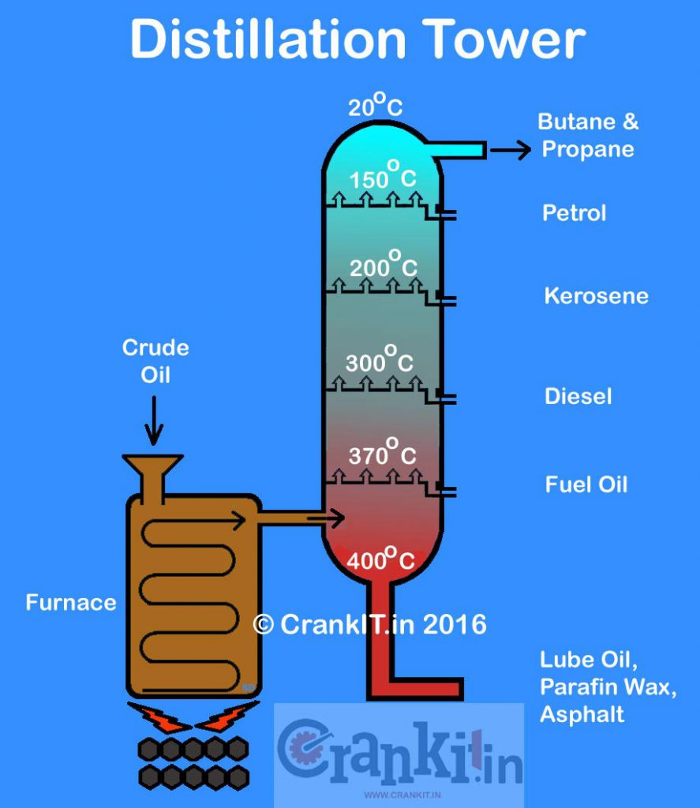
Automotive Engineering Practice
Chapter 1 Applications of Petrol and Diesel Engines
By Ibrahim siraj
Maldives polytechnic

Slide 4
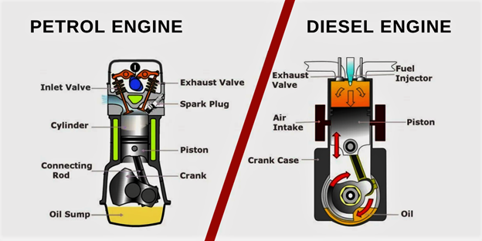
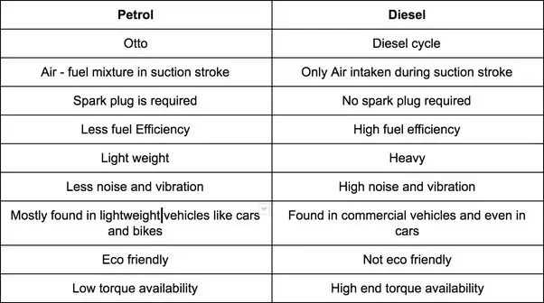
Automotive Engineering Practice
Chapter 1 Applications of Petrol and Diesel Engines
Otto A theoretical model that describes the functioning of a spark-ignition internal combustion engine, commonly known as a four-stroke engine.
thermodynamic model of a four-stroke internal combustion engine that uses compression to ignite fuel, not a spark plug.
By Ibrahim siraj
Maldives polytechnic

Slide 5
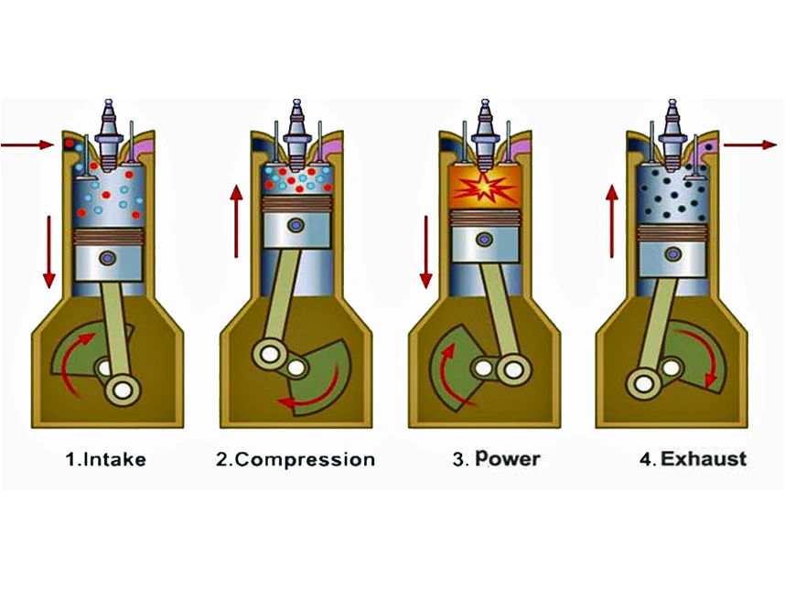
Automotive Engineering Practice
Chapter 1 Applications of Petrol and Diesel Engines Basic Working Principle
The Four-Stroke Cycle
Most modern engines operate on a Four-Stroke Cycle, discovered by Nikolaus Otto (1876).
The four strokes are:
1- Intake (Suction) Stroke
2- Compression Stroke
3- Power (Expansion) Stroke
4- Exhaust Stroke
By Ibrahim siraj
Maldives polytechnic

Slide 6
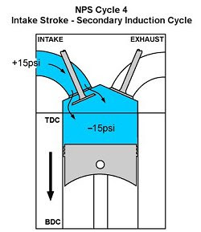
Automotive Engineering Practice
Chapter 1 Applications of Petrol and Diesel Engines Basic Working Principle
1. Intake (Suction) Stroke
Piston moves downward.
Inlet valve opens, exhaust valve closes.
Air-fuel mixture (in petrol engine) or air (in diesel engine) enters the cylinder.
Objective: Fill cylinder with charge for combustion.
By Ibrahim siraj
Maldives polytechnic

Slide 7
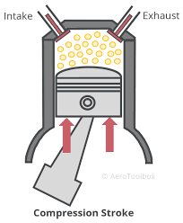
Automotive Engineering Practice
Chapter 1 Applications of Petrol and Diesel Engines Basic Working Principle
2. Compression Stroke
Both valves closed.
Piston moves upward, compressing the mixture (or air).
Compression increases pressure and temperature inside the cylinder.
At the end of this stroke:
Petrol Engine: Spark plug ignites the mixture.
Diesel Engine: Fuel is injected and ignites due to heat of compression.
By Ibrahim siraj
Maldives polytechnic

Slide 8
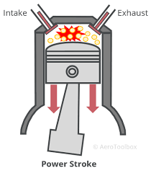
Automotive Engineering Practice
Chapter 1 Applications of Petrol and Diesel Engines Basic Working Principle
3. Power (Expansion) Stroke
Combustion occurs, producing high-pressure gases.
The expanding gases push the piston downward.
This is the only stroke that produces power.
Crankshaft converts this movement into rotational energy.
By Ibrahim siraj
Maldives polytechnic

Slide 9
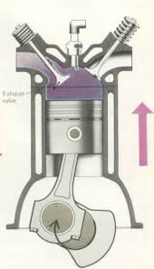
Automotive Engineering Practice
Chapter 1 Applications of Petrol and Diesel Engines Basic Working Principle
4. Exhaust Stroke
Exhaust valve opens, inlet valve closes.
Piston moves upward, pushing out the burnt gases.
Cylinder becomes ready for the next cycle.
By Ibrahim siraj
Maldives polytechnic

Slide 10
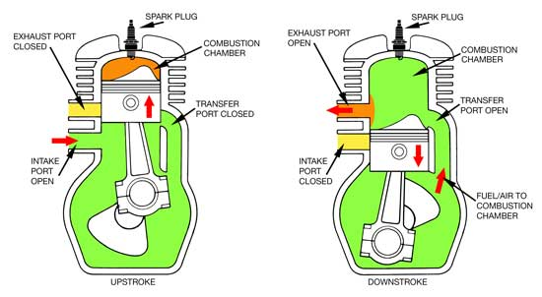
Automotive Engineering Practice
Chapter 1 Applications of Petrol and Diesel Engines Basic Working Principle
Two-Stroke Engine Principle (Optional Slide)
In a two-stroke engine, all four operations occur in two piston strokes (one revolution of crankshaft).
Advantages: Simple design, lightweight, more power for size.
Used in: Motorbikes, scooters, chainsaws.
Disadvantages: Less fuel efficient, more pollution
By Ibrahim siraj
Maldives polytechnic

Slide 11
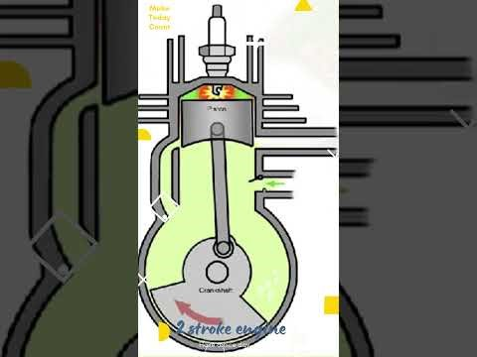
Automotive Engineering Practice
Chapter 1 Applications of Petrol and Diesel Engines Basic Working Principle
Two-Stroke Engine Principle (Optional Slide)
By Ibrahim siraj
Maldives polytechnic

Slide 12
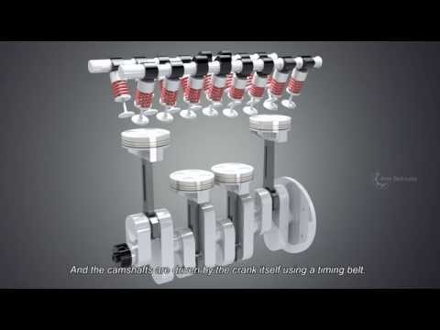
Automotive Engineering Practice
Chapter 1 Applications of Petrol and Diesel Engines Basic Working Principle
By Ibrahim siraj
Maldives polytechnic

Slide 13
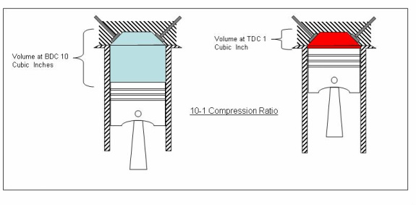
Automotive Engineering Practice
Chapter 1 Applications of Petrol and Diesel Engines
Basic Difference Between Petrol and Diesel Engines
Feature | Petrol Engine | Diesel Engine
Fuel | Petrol (Gasoline) | Diesel
Ignition | Spark Ignition (SI) | Compression Ignition (CI)
Compression Ratio | Low (6:1 to 10:1) | High (14:1 to 22:1)
Efficiency | Lower | Higher
Maintenance | Lower | Higher
A compression ratio is the measure of the maximum cylinder volume (piston at bottom) compared to the minimum volume (piston at top) in an engine
By Ibrahim siraj
Maldives polytechnic

Slide 14
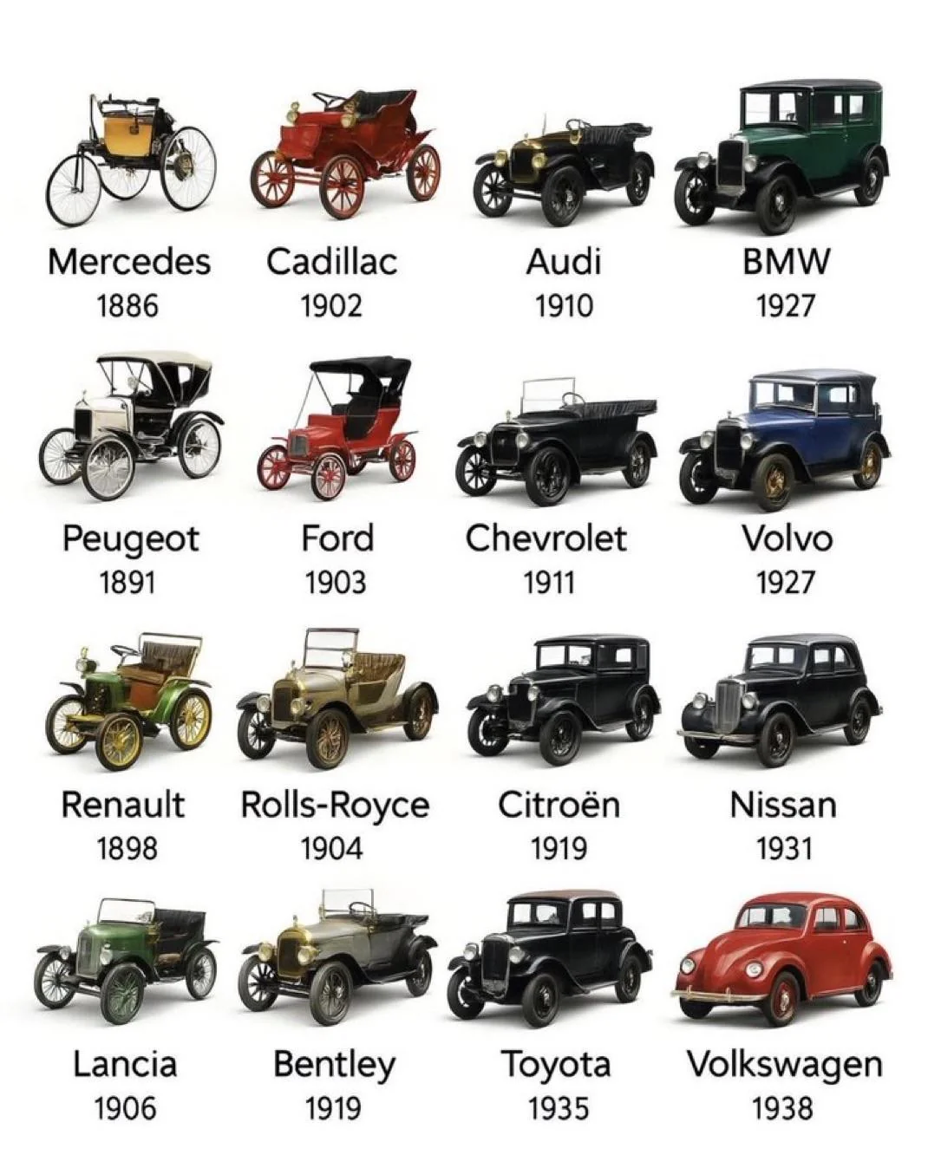
Automotive Engineering Practice
Applications of Petrol Engines
Automobiles:
Cars, motorbikes, scooters, and small trucks.
Popular for light-duty vehicles due to smooth and quiet operation.
Small Machinery:
Lawn mowers, chainsaws, generators, and portable pumps.
Aviation (Light Aircraft):
Used in small aircraft with piston engines
Marine:
Small boats and jet skis where compactness and low vibration are preferred
By Ibrahim siraj
Maldives polytechnic

Slide 15
Automotive Engineering Practice
Chapter 1 Applications of Petrol and Diesel Engines
Applications of Diesel Engines
1. Heavy-Duty Transport:
Trucks, buses, tractors, and lorries use diesel for high torque and fuel efficiency.
2. Power Generation:
Diesel generator sets (DG sets) for electricity backup and remote power supply.
3. Marine Applications:
Large ships, cargo vessels, and submarines rely on diesel engines.
4. Industrial Equipment:
Excavators, cranes, compressors, and mining equipment.
5. Locomotives:
Diesel-electric locomotives for rail transport.
By Ibrahim siraj
Maldives polytechnic

Slide 16
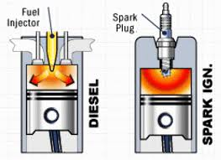
Automotive Engineering Practice
Chapter 1 Applications of Petrol and Diesel Engines
Comparative Advantages
Petrol Engine | Diesel Engine
Smooth, quiet operation | Better fuel economy
Easy starting, especially in cold weather | Higher torque and power for heavy loads
Lower initial cost | Longer lifespan
Lightweight | More durable under high load
By Ibrahim siraj
Maldives polytechnic

Slide 17
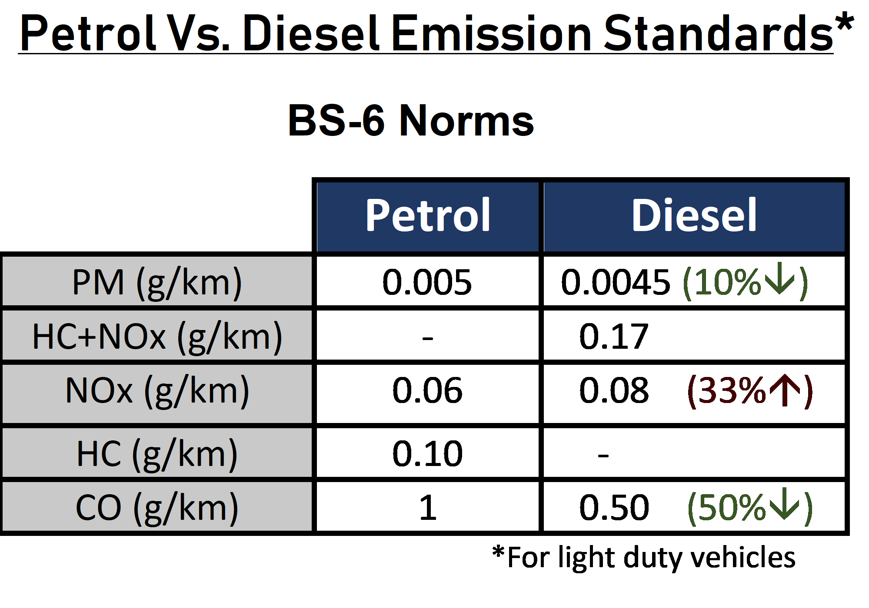
Automotive Engineering Practice
Chapter 1 Applications of Petrol and Diesel Engines
Environmental Considerations
Petrol Engines: Emit more CO2 and unburned hydrocarbons.
Diesel Engines: Produce more NOx and particulates but less CO2.
Both are being improved with turbocharging, fuel injection, and emission control systems.
Particulate Matter (PM)
Hydrocarbons + Nitrogen Oxides
Nitrogen Oxides
Hydrocarbons
Carbon monoxide
By Ibrahim siraj
Maldives polytechnic

Slide 18
Automotive Engineering Practice
Chapter 1 Applications of Petrol and Diesel Engines
Future Trends
Hybrid systems (petrol-electric and diesel-electric).
Cleaner fuels and biodiesel.
Advancements in emission reduction (e.g., catalytic converters, SCR).
Shift toward electric mobility
By Ibrahim siraj
Maldives polytechnic

Slide 19
Automotive Engineering Practice
Chapter 1 Applications of Petrol and Diesel Engines
Conclusion
Both petrol and diesel engines play vital roles in modern life.
Petrol engines dominate light vehicles and portable machinery.
Diesel engines are preferred for heavy-duty and industrial applications.
Continuous innovations aim to make both more efficient and eco-friendly
By Ibrahim siraj
Maldives polytechnic

Slide 20
Automotive Engineering Practice
Chapter 1 Applications of Petrol and Diesel Engines
References
Textbooks on IC Engines (e.g., V. Ganesan, M.L. Mathur & R.P. Sharma)
Manufacturer websites (Cummins, Caterpillar, Honda, Toyota)
Government and automotive energy reports
By Ibrahim siraj
Maldives polytechnic

Slide 21
Automotive Engineering Practice
Chapter 1 Applications of Petrol and Diesel Engines
References
Textbooks on IC Engines (e.g., V. Ganesan, M.L. Mathur & R.P. Sharma)
Manufacturer websites (Cummins, Caterpillar, Honda, Toyota)
Government and automotive energy reports
By Ibrahim siraj
Maldives polytechnic

Slide 22
THANK YOU

